Slide 1

College of computing
Madda walabu university
Department of Information Science
Final Project Presentation
Group-one
Title: Resident Management System For Baha Biftu Kebele In
Robe Town

Slide 2
Introduction
The kebele Resident Management System (KRMS) is introduced as a computerized system to ease the pressure on its user in which information system manually is difficult, because it causes information inconsistency and data integrity problem.
To overcome this information in consistency and integrity we need to have web based data management system. The new resident application system can help to eliminate the paper based applications thereby speeding up processing as details which can captured in the database
This system is prepared for the project to design web based Kebele resident management system.
6/24/2019
RMS for Baha Fiftu Kebele
2

Slide 3
Statement of the Problem
The main problem behind the manual system is that the work is paper based. This creates a lot of problems like:-
Due to redundant data, more space is occupied by file cabinet
It takes more time to find the particular file or data amongst those much bulky manual recording system and residents are not able to access their personal information..
The manual system is costly; the system takes a lot of hard copies and other instruments.
Problems of certificate addressing like Birth certificate, Death certificate
Problems of controlling, retrieving and managing of Files. residents were kept in their paper-filing system
Lack of security: - Documents can be maliciously accessed by anyone and difficult to access the resident information when needed at short notice and removal of resident record.
6/24/2019
RMS for Baha Fiftu Kebele
3

Slide 4
Objectives of the Study
General Objective
The general objective of this Project is to develop web based Kebele resident management system for Baha biftu Kebele in Robe town which solves the above mentioned problems that occurs in the manual system or existing system.
Specific Objective:
To keep the overall records associated with the resident information in a permanent database.
Implement the system based on our design to achieve the desired goal.
Designing a database for the system that can hold all information of the kebele administrations.
Avoiding data redundancy and inconsistency.
Maintaining security of the kebele information.
6/24/2019
RMS for Baha Fiftu Kebele
4

Slide 5
Scope of the study
The scope of this project is developing Kebele resident management System for Baha Biftu Kebele in Robe town only. It has the following activity: -
Registration of Kebele residents/population information.
Prepare Clearance for legal resident who needs to transfer from one place to another place.
Provision of security identification cards to residents.
Online ID card request and Renewal of the identification cards.
Give certificates such as death, birth and other supportive letters to different government and non-government organizations for residents.
Register residents who withdraws residency.
6/24/2019
RMS for Baha Fiftu Kebele
5

Slide 6
Limitation of the study
As a result, the system may not include the following services: -
The system not include related to land.
The study is limited only to the Baha Biftu kebele administrations.
The system cannot access with their local language i.e. limited only to English language.
The system is limited only when electric power and network connection is available.
6/24/2019
RMS for Baha Fiftu Kebele
6

Slide 7
Significance of the Study
The paper waste can be reduced by using cloud platform and electronic format documents instead of printed mails or letters.
Providing a well-organized and guaranteed record keeping system with minimum space and effort need.
Reduce wastage of material such as paper, pen, pencil, human power and time and cost.
Reduce data retrieval time during Searching of Resident Information.
Make the performance of the work more efficient and faster than the manual system.
6/24/2019
RMS for Baha Fiftu Kebele
7

Slide 8
Data Collection Methodology
Interviews
This was the most exhaustible method of data collection. The team used their data superior collection skills to extract data out of the kebele management team, the kebele employees and the kebele’s residents (customers) at the moment of data collection.
Observation Method
The team closely observed the kebele’s activities as the residents are served at the kebele and how the management carried out its managerial activities.
Document Review
Existing official forms will be collected and collated to better understand the system structure that means, both the residents and staff documents were revised. Several data entry errors and retrieval problems were encountered.
6/24/2019
RMS for Baha Fiftu Kebele
8

Slide 9
Problem of existing system
The manual system only provides text based interface which is not as user friendly as Graphical user interface. Since the system is implemented manually, the response is very slow.
Difficult for retrieve personal information of Resident.
Data is not well protected and organized
Time consuming
High space required to store data
Work overload for Officers
Data is not accurate
They are performing every task manual.
Security related problem: due to manual system the protection is less.
6/24/2019
RMS for Baha Fiftu Kebele
9

Slide 10
Functional Requirements (FRs)
User management/authentication: the system allows user creation and user management.
The system can register new residents and those who withdraw residency.
The system can register family members
The system can prepare, Give ID card and renew it
The system can able to give certificates and recommendation (supportive) letters.
The system can able to Search, updating and deleting records.
The system can enable to give clearance for the resident.
6/24/2019
RMS for Baha Fiftu Kebele
10

Slide 11
Non Functional Requirements (NFRs)
Security and Access Permissions
Usability
Availability
Quality issue
Portability
Flexibility
Robustness
Correctness
6/24/2019
RMS for Baha Fiftu Kebele
11

Slide 12
Feasibility of the Study
Technical feasibility: Technical feasibility is the process of assessing the development organization’s ability to construct a proposed system.
Economic feasibility: It is the process of identifying the financial benefits and costs associated with the development project.
Time feasibility: Time feasibility is the process of assessing the degree to which the potential timeframe and completion dates for all major activities within a project meet organizational deadlines and constraints for affecting change
6/24/2019
RMS for Baha Fiftu Kebele
12

Slide 13
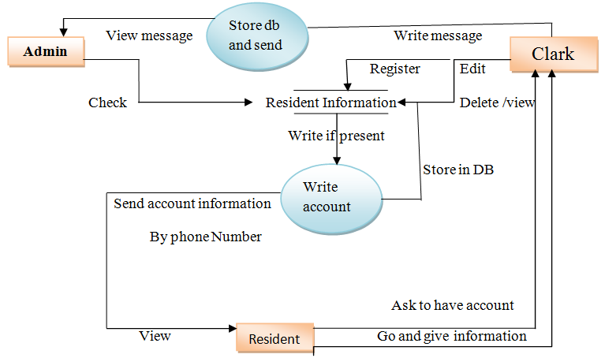
Data Flow Diagram
DFD for creating account for Resident and Registration.
6/24/2019
RMS for Baha Fiftu Kebele
13

Slide 14
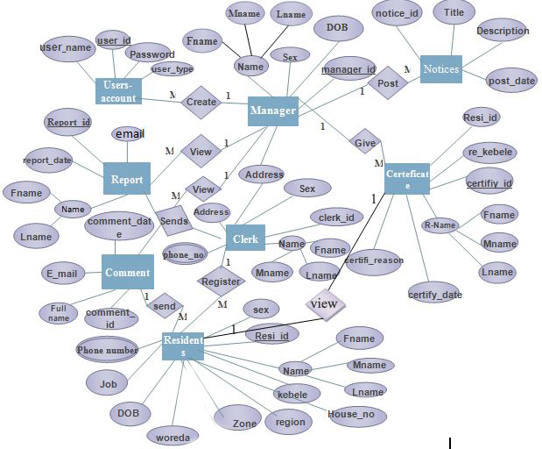
Entity Relationship (ER) Model
ER diagram for Resident Management System
6/24/2019
RMS for Baha Fiftu Kebele
14

Slide 15
Implementation
The objective of Systems Implementation phase is to convert the final physical system specifications into working and reliable software and hardware.
Hardware and software acquisitions for Implementation
For this project implementation, the following hardware and Software’s are used.
Hardware:-Printer: For printing Documentation, Computers, Flash Disk(4 GB), RG 45 cable.
Software:-Microsoft SQL server 2005, Microsoft office2007, Macromedia Dreamweaver, Xampp server, Firefox browser, Adobe photo shop, WordPad.
6/24/2019
RMS for Baha Fiftu Kebele
15

Slide 16
Testing
The purpose of testing can be quality assurance, verification and validation, or reliability estimation.
Unit testing and result: Every module of the System is separately tested. I.e. the team tests every module by applying some selection mechanism.
Integration Testing: In this testing part, all the modules will be combined together and tested it for its fitness with each other and with the systems functionality.
Incremental Testing/Top down testing: There are two primary modules that will need to be integrating. user interface module and the database module (back-end). The two components, once integrated, will form the complete system.
6/24/2019
RMS for Baha Fiftu Kebele
16

Slide 17
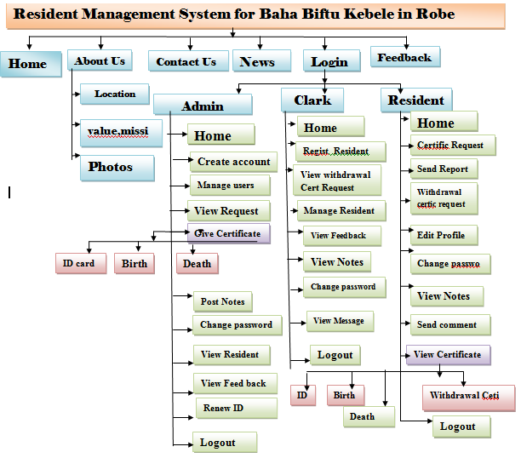
Project Layout
6/24/2019
RMS for Baha Fiftu Kebele
17

Slide 18
The End
Thanks
Let us go the system
IF ANY
IF ANY
6/24/2019
RMS for Baha Fiftu Kebele
18

